Slide 1
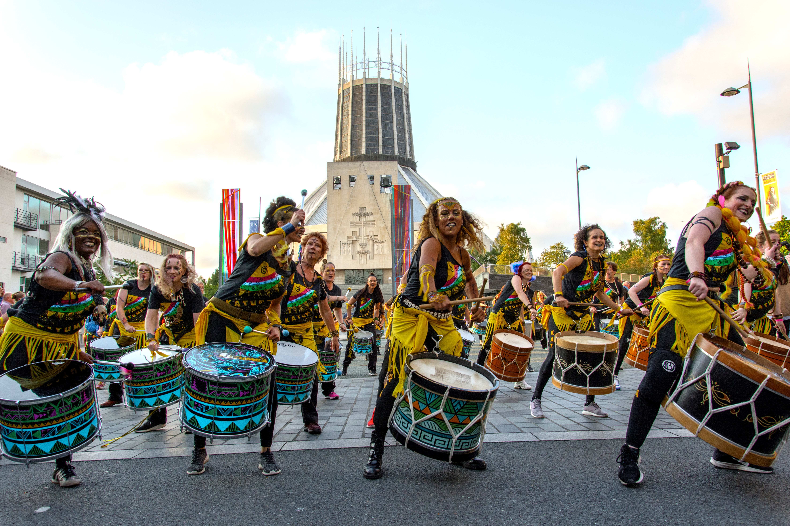
Year 2 Music: Experimenting with sounds 2 – Block A
This is a 5-week sequence with a sixth week available for enrichment, extension or revisiting.
The outline and structure of the block is as follows:
Week 1 | Week 2 | Week 3 | Week 4 | Week 5
Introduce samba music | Body percussion samba | Call and response ostinato | Control volume on untuned percussion | Perform a samba as an ensemble
At the end of this block, pupils will …
Know: | Be able to:
Samba music is made by layering ostinati The names of a range of untuned percussion | Identify an instrument according to the sound that it makes Perform simple ostinati
Samba music, Brazil
CUSP Music Long term sequence | Block A | Block B | Block C | Block D | Block E | Block F
Year 1 Tuned and untuned percussion | Singing | Untuned percussion | Singing | Untuned percussion | Singing | Tuned percussion
Year 2 Tuned and untuned percussion | Untuned percussion | Singing | Untuned percussion | Singing | Tuned percussion | Singing
Year 3 Mastering the glockenspiel | Singing | Untuned percussion | Singing | Glockenspiel | Glockenspiel | Range of instruments studied
Year 4 Mastering the glockenspiel | Untuned percussion | Singing | Glockenspiel | Singing | Glockenspiel | Range of instruments studied
Year 6 Mastering the keyboard | Untuned percussion | Singing | Keyboard | Singing | Range of instruments studied | Keyboard
Year 6 Mastering the keyboard | Singing | Untuned percussion | Singing | Keyboard | Keyboard | Range of instruments studied

Slide 2
Long term sequence:
Year | Block A | Block B | Block C | Block D | Block E | Block F
1 Tuned and untuned percussion | Singing | Untuned percussion | Singing | Untuned percussion | Singing | Tuned percussion
 | Singing focus: Being together in music | Untuned focus: Introducing rhythm and pulse | Singing focus: Introducing pitch | Untuned focus: Introducing tempo and dynamic | Singing focus: Exploring emotions through music | Tuned focus: Experimenting with sounds (duration)
 | Control the voice – nursery rhymes | Representing sounds pictorially | Identify changes in sounds (high/low) | Identify changes in sounds (fast/slow, loud/soft) | Responding to music | Representing sounds pictorially
2 Tuned and untuned percussion | Untuned percussion | Singing | Untuned percussion | Singing | Tuned percussion | Singing
 | Untuned focus: Experimenting with sounds 2 | Singing focus: Being together in music 2 | Untuned focus: Introducing rhythm and pulse 2 | Singing focus: Introducing pitch 2 | Tuned focus: Introducing tempo and dynamic 2 | Singing focus: Exploring emotions through music 2
 | Exploring ostinato | Control the voice – sing as a choir | Compose short patterns | Control and describe pitch | Control and describe tempo and dynamic | Choose sounds to create an effect
3 Mastering the glockenspiel | Singing | Untuned percussion | Singing | Glockenspiel | Glockenspiel | Range of instruments studied
 | Singing focus: Introducing texture | Untuned focus: Mastering rhythm | Singing focus: The history of singing | Tuned focus: Musical notation | Tuned focus: Composition | Performance focus: Introducing timbre
 | Sing parts in an ensemble (e.g. rounds) | Recognise beats in a bar (time signatures/metre) | Singing for togetherness e.g. folk songs, war chants, hymns | Introduce the staff | Compose in pairs | Perform as an ensemble (range of instruments)
4 Mastering the glockenspiel | Untuned percussion | Singing | Glockenspiel | Singing | Glockenspiel | Range of instruments studied
 | Untuned focus: Mastering rhythm 2 | Singing focus: Introducing texture 2 | Tuned focus: Musical notation 2 | Singing focus: The history of singing 2 | Performance focus: Composition 2 | Tuned focus: Introducing timbre 2
 | Follow beats in a bar (time signatures/metre) | Sing parts in an ensemble (harmony) | Revisit the staff | Singing for entertainment e.g. opera, theatrical, modernism | Perform including an element of composition | Identify and describe how sounds are combined
5 Mastering the keyboard | Untuned percussion | Singing | Keyboard | Singing | Range of instruments studied | Keyboard
 | Untuned focus: Musical stories | Singing focus: Introducing structure | Tuned focus: Musical notation 3 | Singing focus: Music technology | Performance focus: Composition 3 | Tuned focus: Improvisation
 | One piece, different performers | Identify parts of a song | Follow musical notation | Alter pitch and dynamic to create effects | Perform including an element of composition | Improvise using repeated patterns
6 Mastering the keyboard | Singing | Untuned percussion | Singing | Keyboard | Keyboard | Range of instruments studied
 | Singing focus: Musical stories 2 | Untuned focus: Music technology 2 | Singing focus: Introducing structure 2 | Tuned focus: Musical notation 4 | Tuned focus: Composition 4 | Performance focus: Improvisation 2
 | Cultural and social - lyrics | Alter tempo and rhythm to create effects | Identify cyclic patterns inc. verse/chorus, coda | Create simple notation | Improvise using melodic phrases | Perform including an element of improvisation

Slide 3
Point of reference:
Y2 Experimenting with sounds 2 – Block A
Pupils will be able to:
play simple copy-cat rhythms
move to the beat of a song
have some experience of playing percussion instruments.
Prior Learning
Summary of key learning:
In this block, pupils will learn about the origins of samba music. They will have the opportunity to play a range of untuned percussion with a greater degree of control. Pupils will play simple ostinato call and response rhythms and compose their own basic rhythms. They will learn to follow simple conducting directions and will rehearse and perform as an ensemble.
Key pieces:
Fanfarra (Cabua-Le-Le), Sérgio Mendes / Carlinhos Brown Sérgio Mendes is a Brazilian musician who specialises in playing jazz and samba music. The song Fanfarra (Cabua-Le-Le) features Brazilian singer and percussionist, Carlinhos Brown. This song is the title track on the album Brasileiro which won the 1993 Grammy Award for the Best World Music Album. Teacher note – ensure you have listened to each piece prior to the lesson (available on the internet).
Resources:
drums whistle (teachers) A range of untuned percussion including: agogo tambourine shakers maracas claves castanets triangles cowbell
Becoming a musician
Pitch | Duration | Rhythm and pulse | Tempo and dynamic | Timbre | Texture | Structure
High and low sounds | The length of sounds – how long they are sustained for | Pulse – the steady beat Rhythm – patterns that happen over the beat | Tempo – the speed of the music Dynamic – how loud or quiet music is | The sound quality of certain instruments | Layers of sound working together | How a piece of music is built

Slide 4
Point of explanation:
Y2 Experimenting with sounds 2 – Block A
Core Knowledge | Explanation
rhythm | long and short sounds or patterns that happen over the pulse, the steady beat
pulse | the regular heartbeat of the music; the steady beat
ostinato | a musical figure or rhythm repeated persistently throughout a piece of music
samba | a lively Brazilian music genre made up of rhythmic patterns
percussion | musical instruments that can be played by striking or shaking
ensemble | a group of people who perform music together
dynamic | the variation in the volume of a piece of music
Link to video: https://vimeo.com/744474524/f97a450d46 Please watch this in conjunction with reading the lesson planning.
Explanation and demonstration of taught content Lesson-by-lesson guidance Exemplification of techniques and outcomes

Slide 5
Audio clips: Y2 Experimenting with sounds 2 – Block A
Lesson | Description
1 | Identifying instruments
2 | Body percussion samba
3 | Call and response
4 | Controlling volume
5 | Play along samba
Click the speaker symbol to play the clip. This can be paused and replayed as needed throughout the lesson.

Slide 6
Point of delivery:
Y2 Experimenting with sounds 2 – Block A
Revisiting prior learning |  | Taught content | Point of practice | Point of reflection
1. | Revisiting key vocabulary: rhythm pulse | Reference lesson: The origins and style of samba music Describe the sounds that different untuned percussion makes. | Introduce the block by playing a version of Fanfarra (Cabua-Le-Le) by Sérgio Mendes. Explain that this is samba music. Note that this originates from Brazil and locate this on a world map or globe. Ask pupils to describe the music and how it makes them feel. Use the Vocabulary task to structure discussion and revisit the terms rhythm and pulse. Replay the music and encourage pupils to move, walk or tap along to it. Introduce a range of untuned instruments one by one (e.g. agogo, drums, tambourine, claves). Demonstrate how each can be played. Collect vocabulary that describes the sound that each instrument makes. Play the audio clip and ask pupils to identify when a new instrument is added and which instrument they can hear each time. Replay the audio clip and tap out the pulse. Note the difference between the rhythm and the pulse. | Can identify an instrument from its sound Can describe the sound an instrument makes Can move or clap along to the pulse of a composition
2. | Revisiting the origins and style of samba music | Knowledge about music: Samba music can be found in carnival celebrations . An ostinato is a rhythmic pattern that is repeated throughout a composition. | Revisit the origins of samba music. Locate Rio de Janeiro on a map of Brazil. Explain the origins and traditions of the famous carnival. Note that samba music is used as part of the celebrations and that it is often played by large ensembles, making it very loud. Teach pupils the word ostinato. Explain that samba music is made by layering ostinato on top of each other. Listen again to the samba music played in the previous lesson. Pause and note key patterns. Explain that the players in a samba band follow signals from the lead repenique (metal drum) player who sometimes uses a whistle to signal a change of rhythm. Play the audio clip and teach pupils to stamp the first rhythm, pat the second rhythm on their knees and clap the third rhythm. Rehearse each of these as a class. Explain that each one is an ostinato that could be repeated throughout a composition. Split the class into three and give each group one ostinato to play. Use the whistle to introduce each rhythm in turn to create a simple samba composition. | Can explain the origins of samba music Can identify and mimic simple ostinato Can play body percussion as part of an ensemble

Slide 7
Point of delivery:
Y2 Experimenting with sounds 2 – Block A
Revisiting prior learning |  | Taught content | Point of practice | Point of reflection
3. | Following a word pattern chant e.g. app – le pie hot app-le pie app-le pie and cust-ard | Becoming a musician: Compose and perform short ostinati. Music can be notated using symbols or marks to represent each beat. | Explain that part of being a musician is creating our own compositions. Discuss the importance of experimentation and rehearsal. Remind pupils of call and response phrases in music. This could relate to previous singing experiences (e.g. Who built the Ark?). Listen to the first audio clip. Explain that this is a call. Model developing a response to this, clapping it first and then selecting an instrument to play it on. Record this using simple marks or symbols that show each beat that you play. Guide pupils through developing a class response to the second audio clip, following the same process of clapping it first, selecting an instrument to play it on and notating the rhythm so that it can be followed. Pupils work in pairs or groups to respond to the third audio clip, composing and developing their own response to the call. Challenge pupils to record this using the notation symbols you have created. Play the full audio through with pupils joining in with their responses. This could be by using different untuned instruments or by clapping their rhythms. | Can perform simple call and response rhythms on untuned percussion Can record simple rhythms pictorially
4. | Identifying a range of percussion instruments | Knowledge about music: Volume can be controlled by the way an instrument is played. | Present pupils with a range of untuned percussion. Ask them to work in pairs to practise naming them. Sort the instruments according to those that are played with a beater and those that are played with our hands. Note any that can be played with either (e.g. a drum). Explain that the volume of an untuned instrument can be controlled by how hard we hit it. Play the audio clip and model playing the first ostinato and gradually increasing and decreasing the volume. Introduce the terms crescendo and decrescendo. Agree a conducting code for increasing and decreasing volume (e.g. moving your hands apart for louder and together for quieter). Give pupils different untuned percussion instruments. Allow them to investigate how they can control the volume of their instrument. Rehearse the second ostinato from the clip, experimenting with controlling the volume and following conducting directions. Rehearse and perform this as a class. | Can control the volume of an untuned instrument Can follow simple conducting directions

Slide 8
Point of delivery:
Y2 Experimenting with sounds 2 – Block A
Revisiting prior learning |  | Taught content | Point of practice | Point of reflection
5. | Revisiting key vocabulary: volume dynamic crescendo decrescendo | Becoming a musician: Perform as part of an ensemble. Follow simple conducting directions. | Use the Vocabulary quiz to revisit key vocabulary from the block. Play the audio clip in full. Ask pupils to describe the music and how the dynamic changes as new instruments are added. Rehearse the conducting symbols for increasing and decreasing volume. Rehearse the ostinati learnt in Lesson 4, with each pupil now playing an instrument. Organise the class into two groups, assigning each group one of the ostinati to play. Replay the clip and bring in each group in turn, gradually increasing their volume throughout the piece. Rehearse this until pupils can confidently keep up with the music and follow conducting directions. Challenge pupils to perform this to another class or record it to share with families. Give pupils time to reflect, evaluating their own and the collective performance. Use the second vocabulary task to structure pupils’ responses. | Can keep the beat when playing as part of an ensemble Can follow simple conducting directions
6. |  | Flexible content | Use this lesson for enrichment, extension or reteaching key concepts that pupils need more time to master.
Questions for assessment
How would you describe samba music? | Can you play along with this rhythm?
Which instruments can you hear? | Can you march to the beat of this music?
What is the name of a repeating rhythm? | How would you make this instrument louder?
What does this sign mean? (e.g. crescendo / decrescendo) | Which part of your performance were you proud of?
Can you name these instruments? | Which part of the performance did you find challenging?

Slide 9
Oracy and Vocabulary:
Y2 Experimenting with sounds 2 – Block A
Task 1:
excited
gleeful
calm
energetic
jolly
tired
frustrated
annoyed
miserable
Tick the words that best describe how you feel about Fanfarra (Cabua-Le-Le), by Sérgio Mendes / Carlinhos Brown.
Explain to a partner why it made you feel this way.
Challenge yourself to use the words rhythm and pulse.
Use these sentence starters to help you with your explanation.
The samba music made me feel …
It made me feel like this because …
My favourite part of the song was …
Task 2:
say
say
Task 2: on a scale of 1 to 10 (1 is very disappointed – 10 is very satisfied),
what number would you give your feelings about the class performance?
Describe how you created these rhythms on the instruments you were playing. Explain what you would do differently next time.
say
say

Slide 10
Vocabulary: Y2 Experimenting with sounds 2 – Block A
OWN-it Analyse
The word crescendo means: to grow louder to grow quieter.
Underline the part of the word decrescendo that means down. decrescendo
The word ostinato comes from the word: obstinate otherwise.
KNOW-it Define
An ostinato is … a repeating rhythm a song about an ostrich.
True or false? Pulse means the same as rhythm. □ True □ False
Draw a picture of a carnival.
LINK-it Connect
Circle the word that means the same as steady beat. pulse rhythm
Write the word for a group of instruments that we play by hitting or shaking them. ______________________________________
Write two words that connect with the word samba. _________________ _________________
USE-it Use in context
Complete the sentence below. The volume of a piece of music is how ________ or ______________ it is.
Use the word conductor correctly in a sentence about music.
Write the name that describes the group of instruments below. drum triangle claves ______________________________________

Slide 11
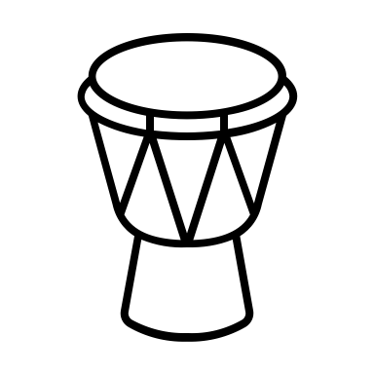
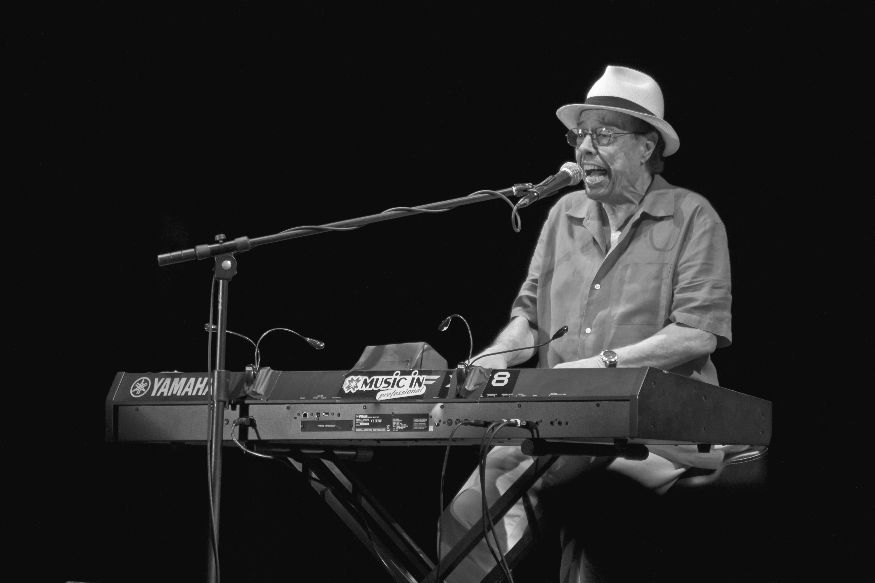
Knowledge Note:
Y2 Experimenting with sounds 2 – Block A
Year 2: Experimenting with sounds 2
Core content: Rehearse, create and perform a range of ostinati on untuned percussion. Technical vocabulary: rhythm – a regular repeated pattern of sound pulse – the steady beat ostinato – a repeating rhythm played throughout a piece of music crescendo – increase volume decrescendo – decrease volume percussion – musical instruments that can be played by striking or shaking
Connections: Samba music – made with layers of ostinato performed by a large group using several percussion instruments Fanfarra (Cabua-Le-Le), by Sérgio Mendes
Year 2: Experimenting with sounds 2
Core content: Rehearse, create and perform a range of ostinati on untuned percussion. Technical vocabulary: rhythm – a regular repeated pattern of sound pulse – the steady beat ostinato – a repeating rhythm played throughout a piece of music crescendo – increase volume decrescendo – decrease volume percussion – musical instruments that can be played by striking or shaking
Connections: Samba music – made with layers of ostinato performed by a large group using several percussion instruments Fanfarra (Cabua-Le-Le), by Sérgio Mendes
<
<
<
<

